Slide 1

Social Listening of Beachbody’s
Twitter and Facebook

Slide 2
POST
Purpose
Present findings on Beachbody’s social listenting
Find the top 25 most common hashtags associated with Beachbody over the course of 1 week
Visualize the top 25 as a histogram to show the distribution of each
Outcome
Definition of next steps
Structure
Presentation and potential visualization on separate platform
Time
30 minutes?

Slide 3
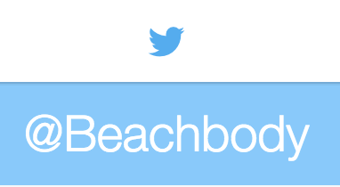
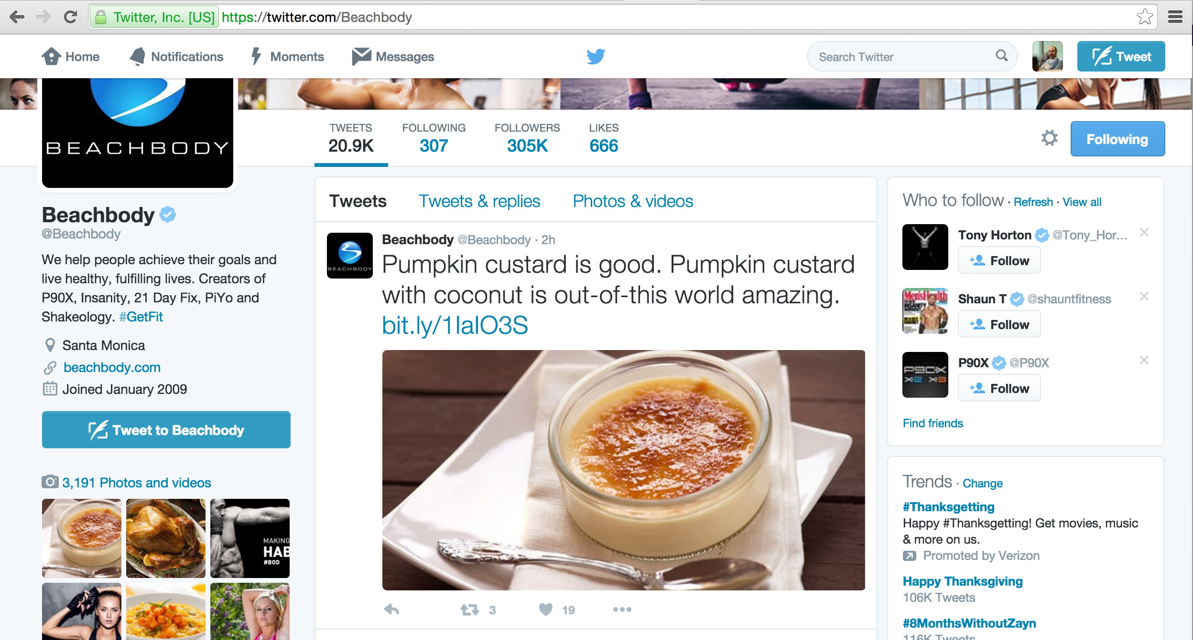
from 11/13 to 11/24
@Beachbody was mentioned in 1,400 tweets
371 Original Tweets
1029 Re-tweets

Slide 4
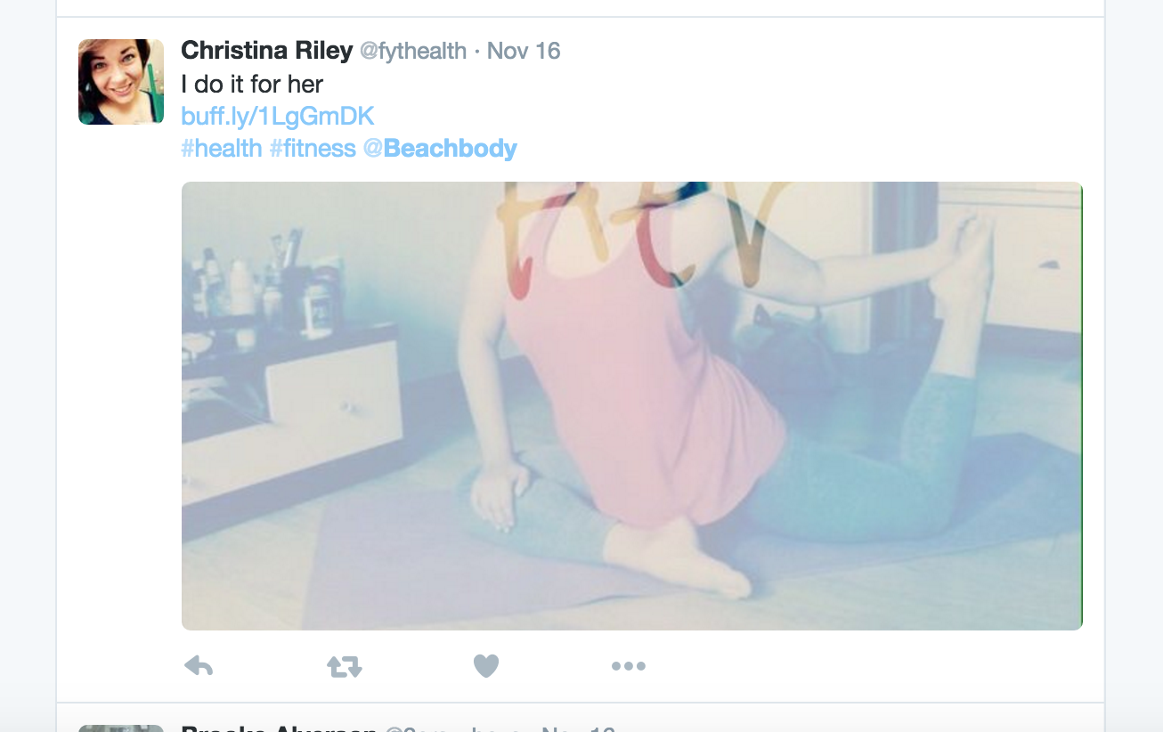
User @Beachbody mentioned on the Tweet
Hashtags
Retweeted

Slide 5
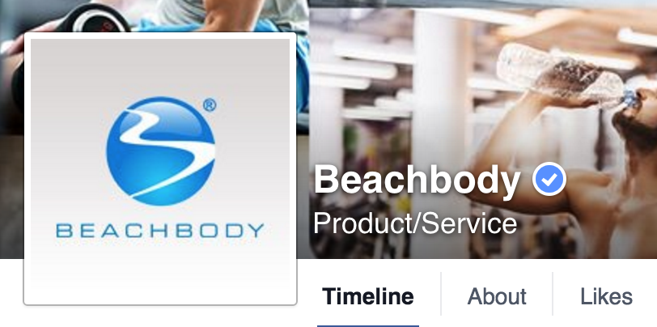
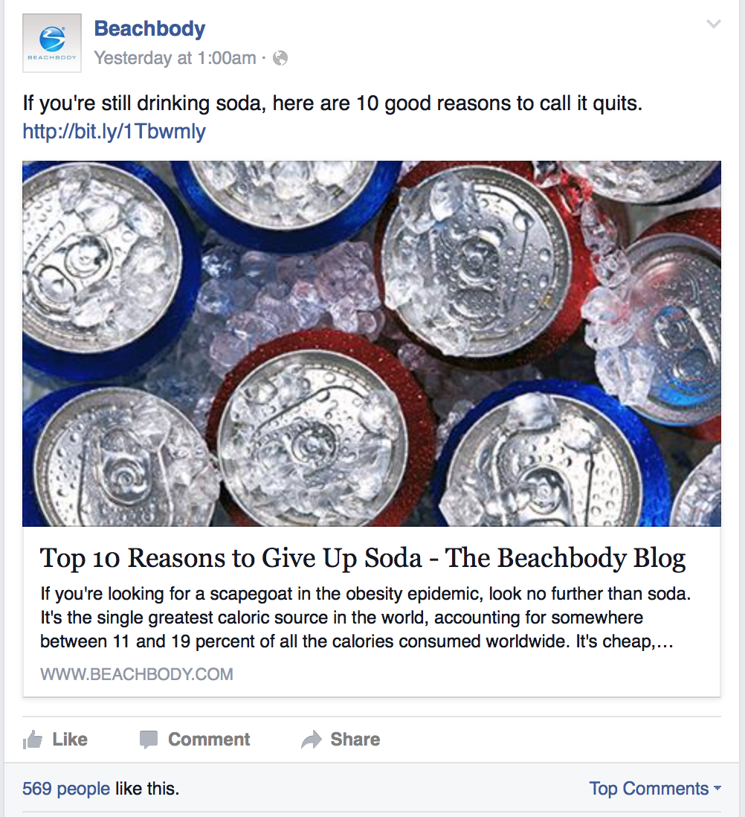
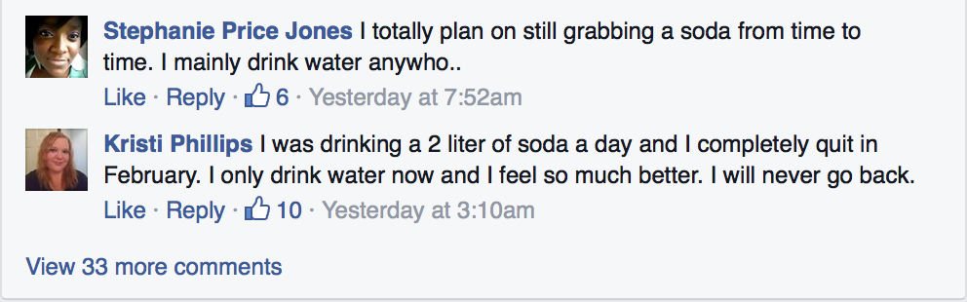
Beachbody Facebook Page
Follower’s comments

Slide 6
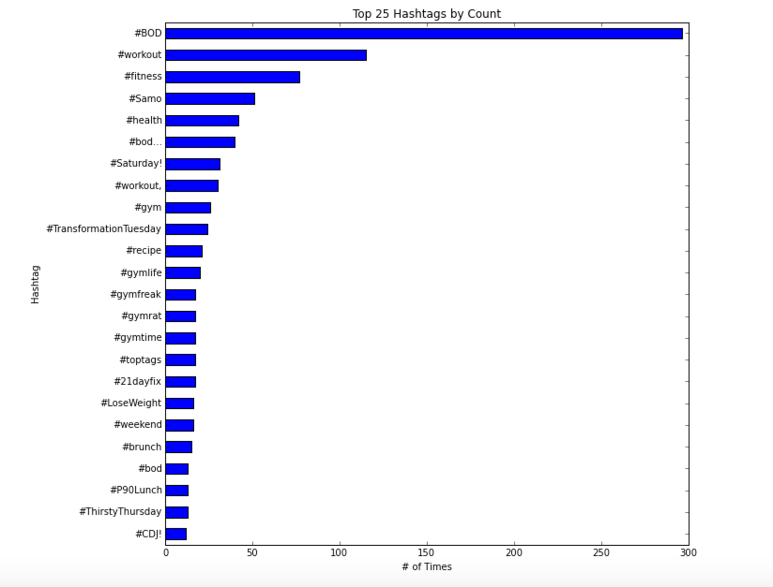
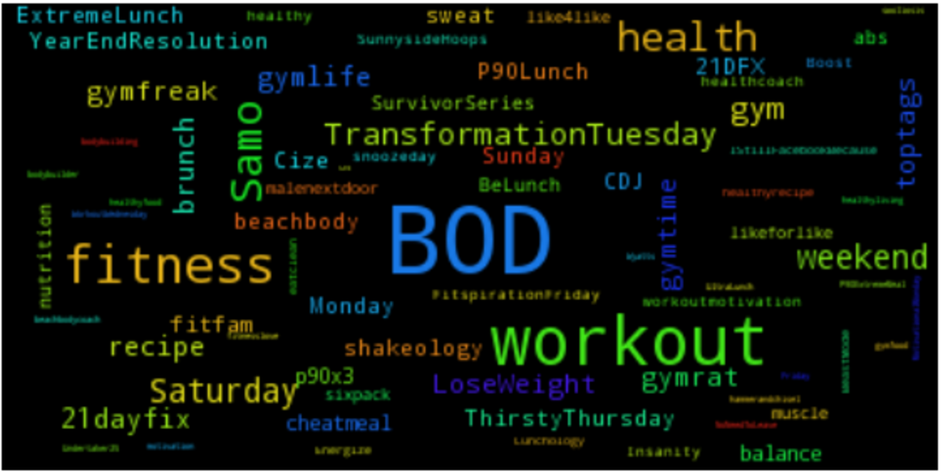
Top 25 most common hashtags associated with Beachbody over the course of 1 week
from 11/13 to 11/24
@Beachbody was mentioned in 1,400 tweets
371 Original Tweets
1029 Re-tweets

Slide 7
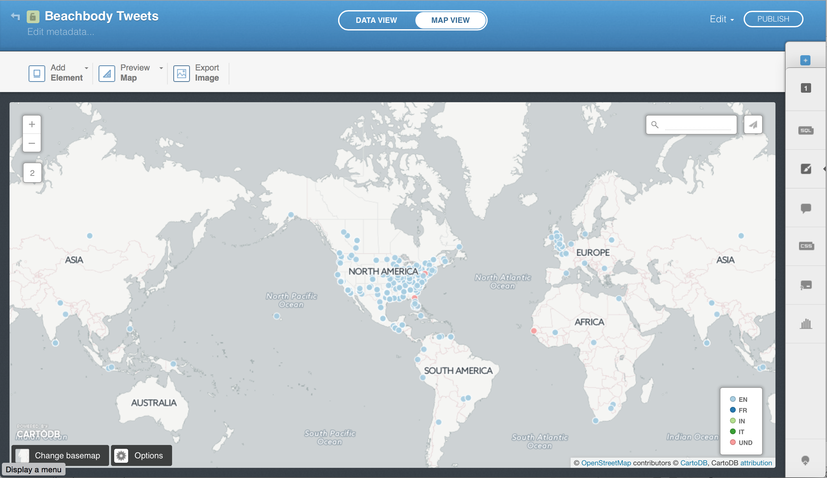
User Geographies
CartoDB

Slide 8
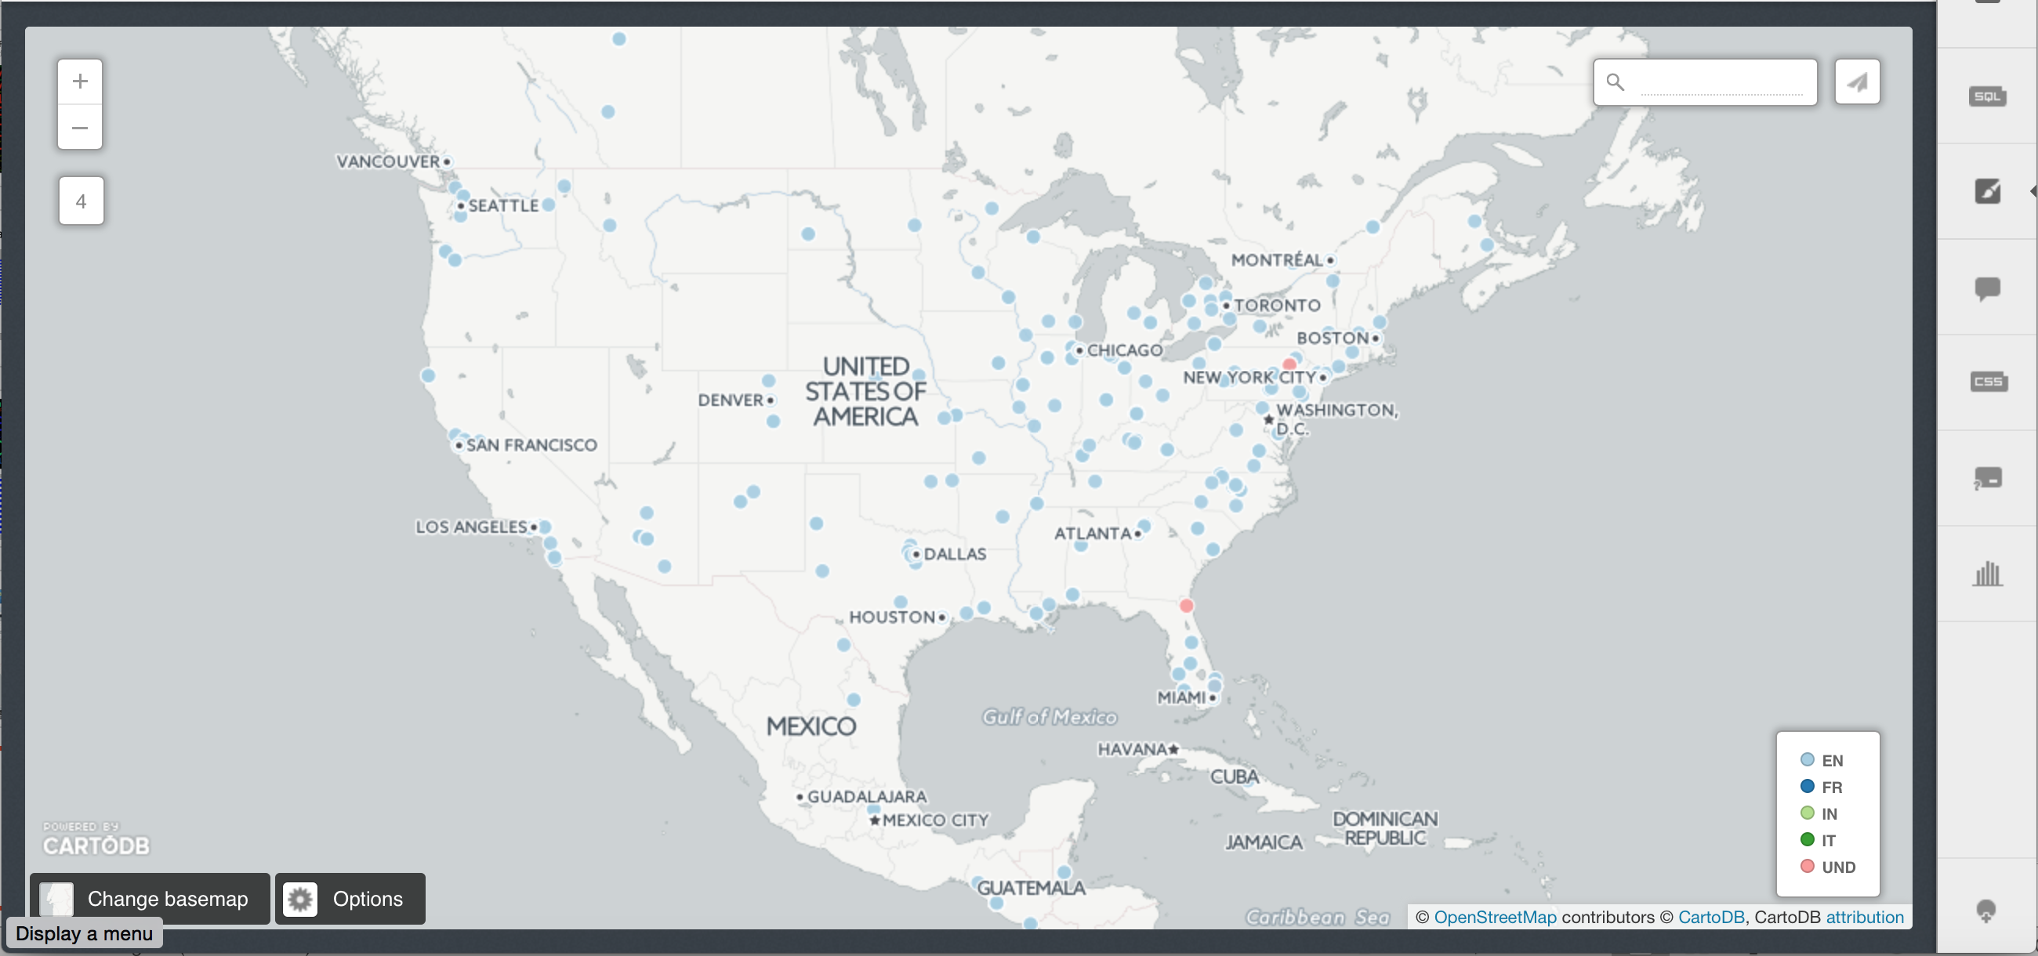
User Geographies
CartoDB

Slide 9
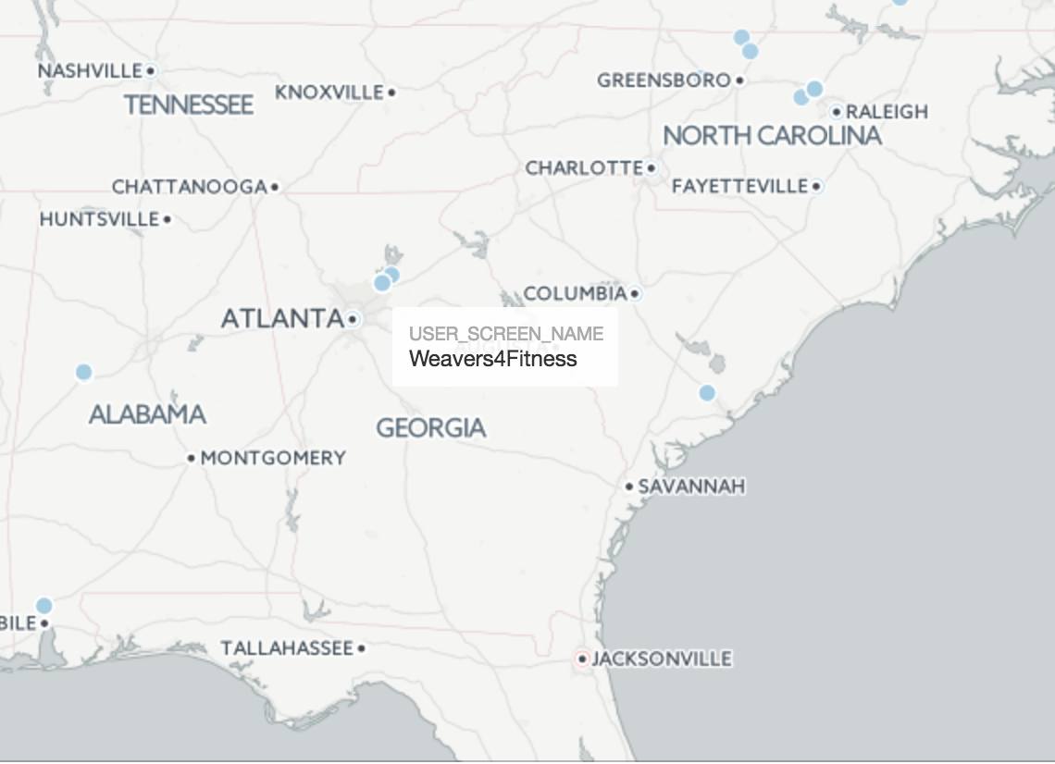
User Geographies
CartoDB

Slide 10
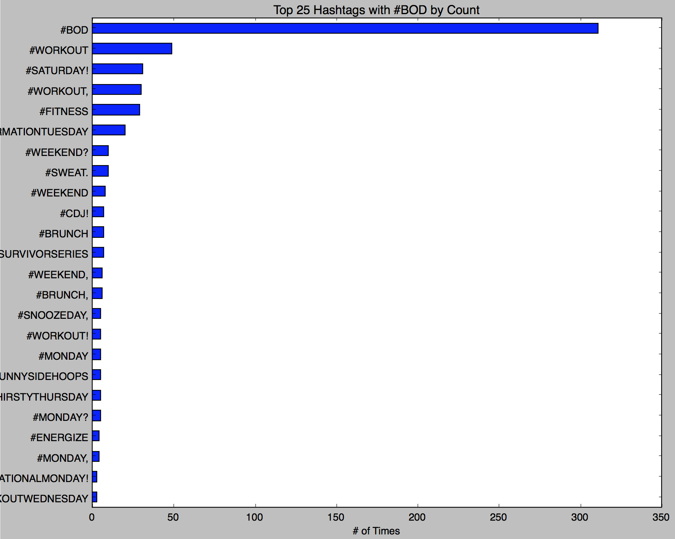
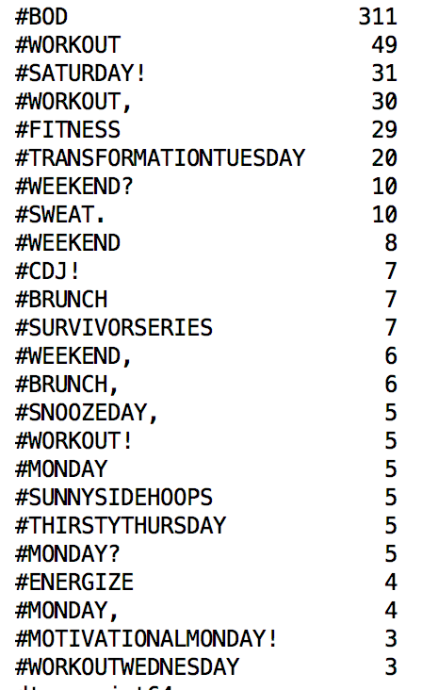
Top 25 most common hashtags associated with Beachbody and #BOD

Slide 11
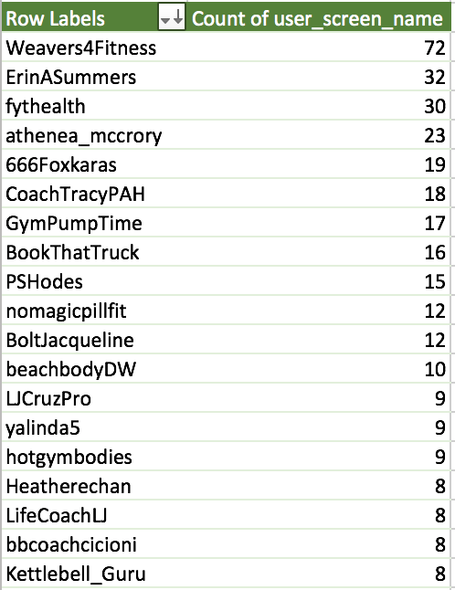
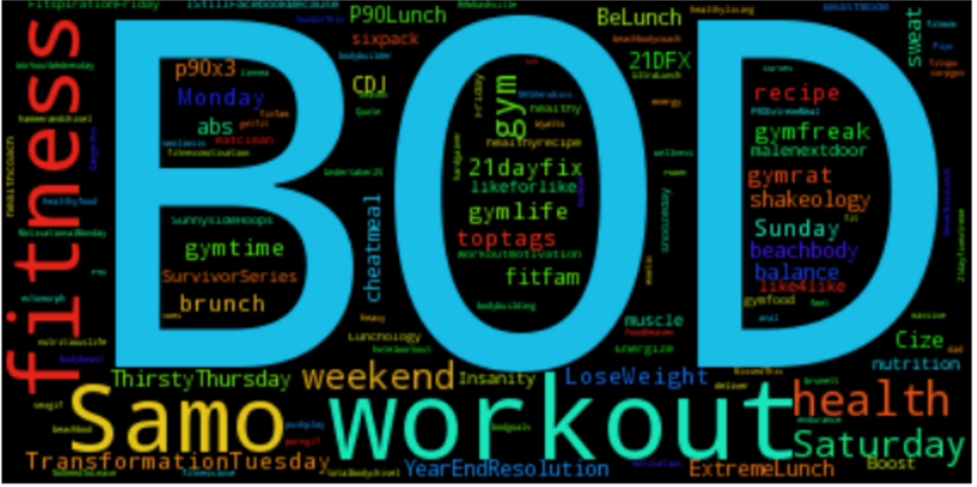
Most active users (re-tweeted @Beachbody’s tweet)

Slide 12
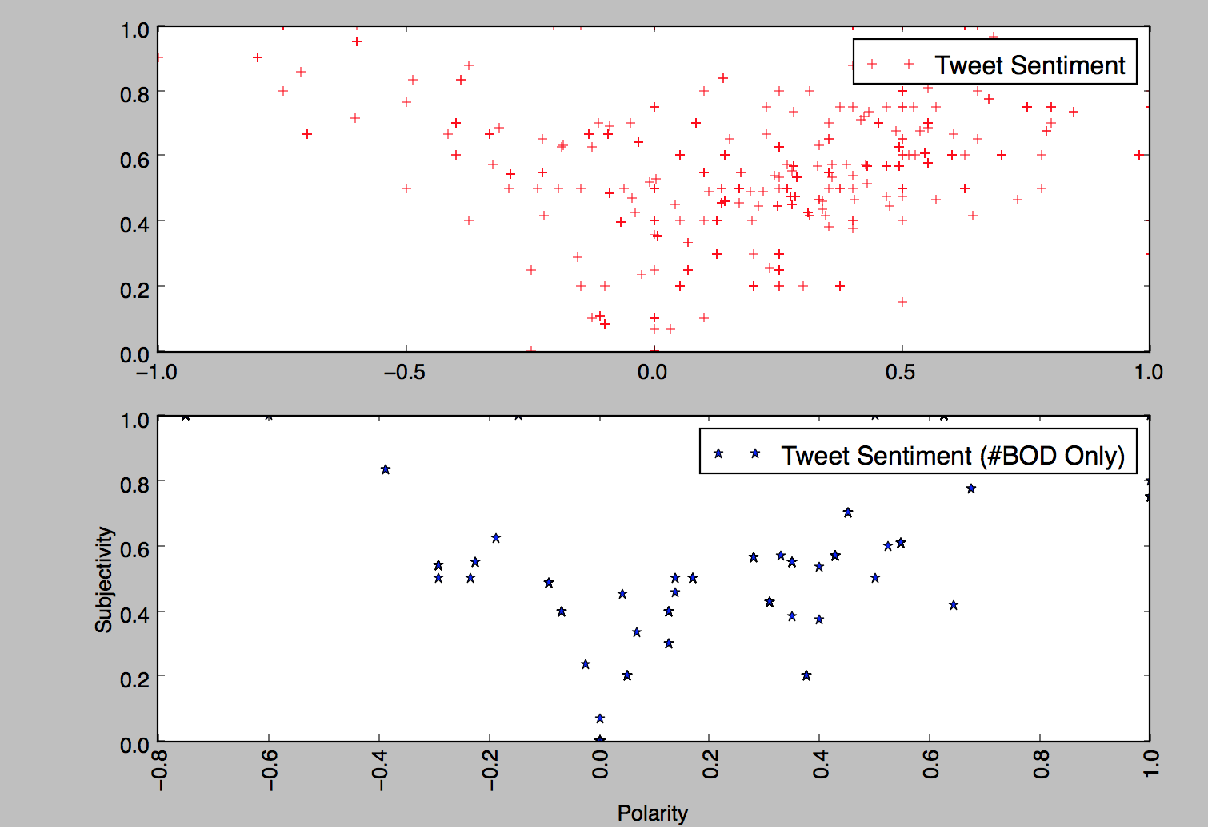
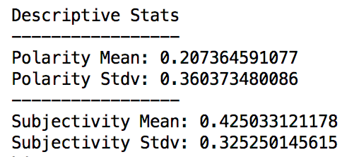
Sentiment Analysis on Tweets

Slide 13
Tweets with high Polarity (>=0.6)
“@P413_Life: @Beachbody @beachbodylive @PiYoWorkout @michelepark is awesome! I'm so grateful for her modified moves in PiYo!”
“@Fitness_Avenger My best friend @IDTheJC is a @Beachbody coach. He's the one who got me set up with it.”
“@Beachbody Honestly, I drone it to begin with because I have to get it done, and 5 minutes in, I'M PUMPED!”
“@Beachbody @BB_Performance performance has improved my endurance, has taken away my muscle sourness, I'm in love with the products!!”
“Love this! 3 Words, Man!! @21DayFix #21DFX @Beachbody https://t.co/ajtYBqtZDD”
‘This is the best thing that can happened to me!, thanks @shauntfitness @Beachbody #FlexFriday i feel AMAZING!!! https://t.co/rEhRLDCdrH”
“@BeachbodyUK absolutely love it! Why people think it's just for beginners is beyond me?! It's great for all abilities #P90 #rocks”
“@yamifitness25: Pretty happy with this!!! #fitnessmotivation #fitlife #fitfam #fitspo #fitness #fitinspiration #bod… https://t.co/m1immp8ddb”
“Did this today on #BOD absolutely loved it!! Can't wait for it to come out!! #hammerandchisel https://t.co/u4B4iMQ7Cr”
“So happy for the amazing customer service @Beachbody ! :)”
“@jmorin24 @21DayFix @Beachbody LOL love it”

Slide 14
Tweets with negative Polarity (Literal)
“@Beachbody im seriously about to cancel my order. ..im received two emails saying my shipment is delayed and now won't ship until the 16th!”
“Thanks @Beachbody for fucking up my order which is going to be late, not sending a tracking #, and for your staff being completely useless😊”
“I'm so disappointed @Beachbody ... Especially after being hung up on my customer service...”
“@Beachbody terrible, canceled an order over a month ago only to have it billed this month bc someone postponed it instead of canceling #fail”
“It's really frustrating when I wake up at 5am and my @beachbody on demand is not working from any device!!! Ugh!!!”
“@Beachbody Can you please help me with a faulty purchase I bought from your website...I've emailed so many times but nobody ever replies!”
“False Positive”
“RT @Beachbody: Never let a bad playlist ruin a workout again. This Spotify channel has everything you need. https://t.co/dZUZrLuKxc https:/…”

Slide 15
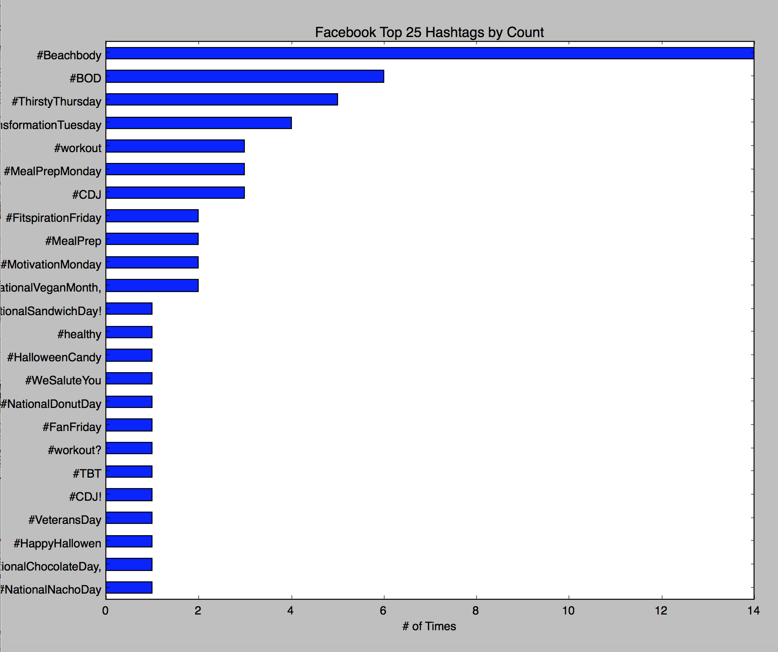
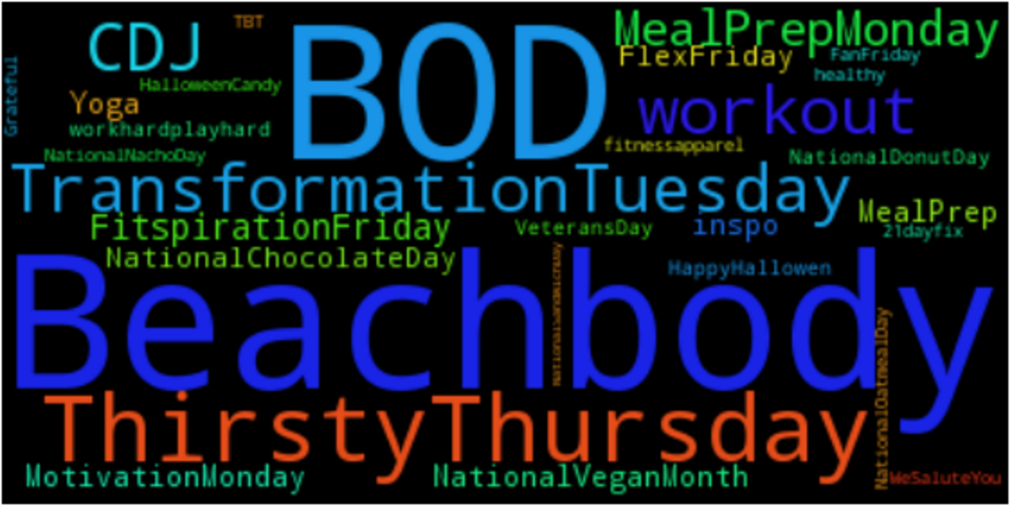
Facebook (11/1 to 11/24)
from 11/1 to 11/24
160 Comments on Facebook page

Slide 16
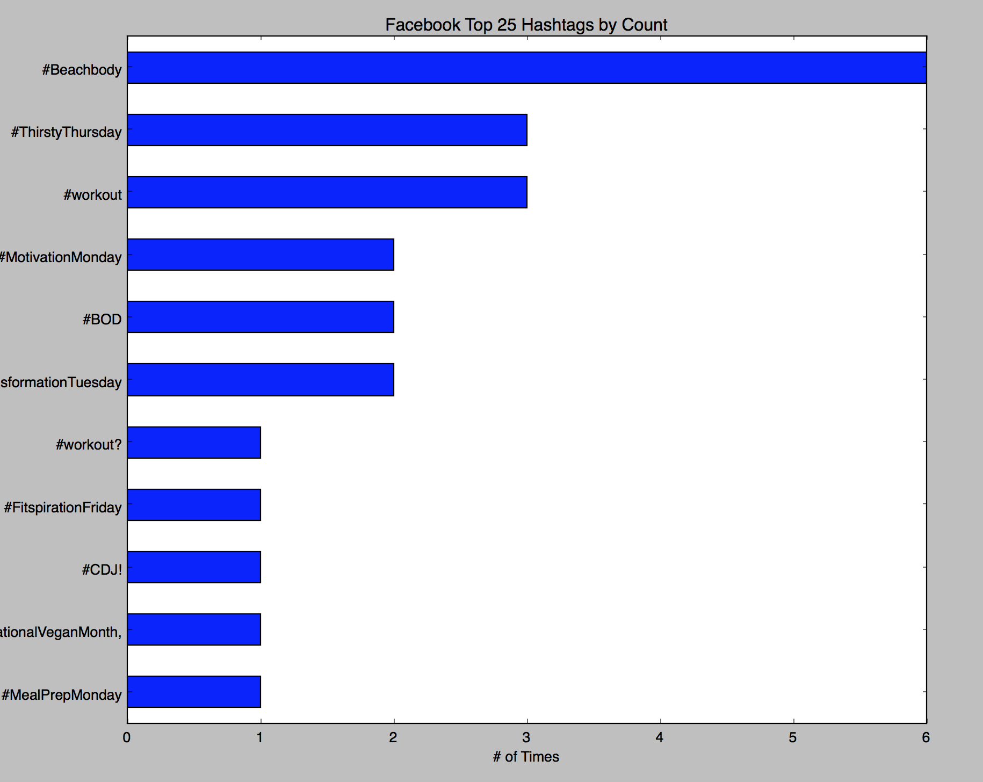
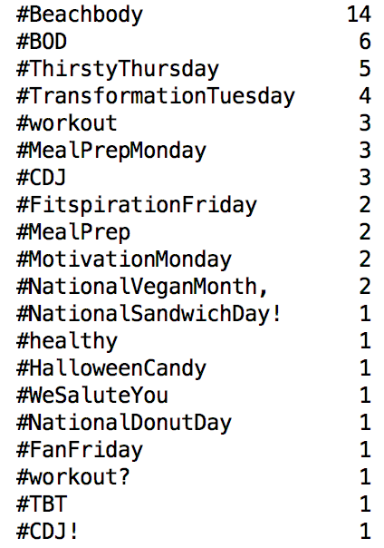
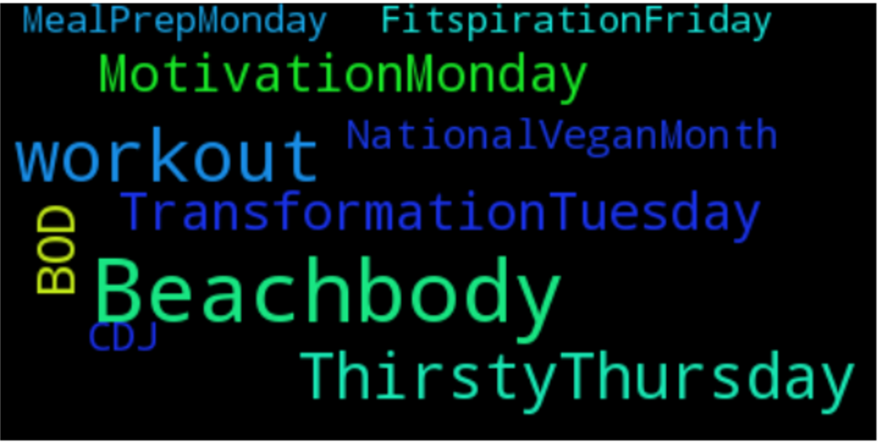
Facebook
(from 11/13 to 11/24)

Slide 17
Appendix

Slide 18
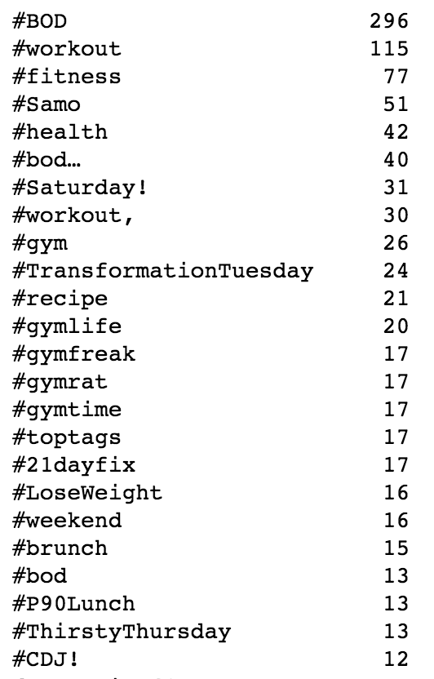
Top 25 most common hashtags associated with Beachbody over the course of 1 week

Slide 19
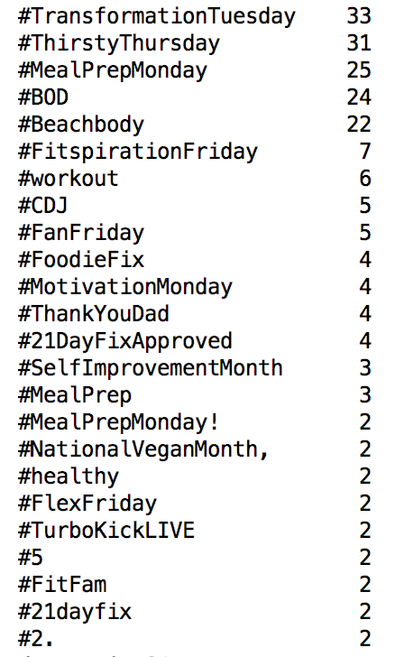
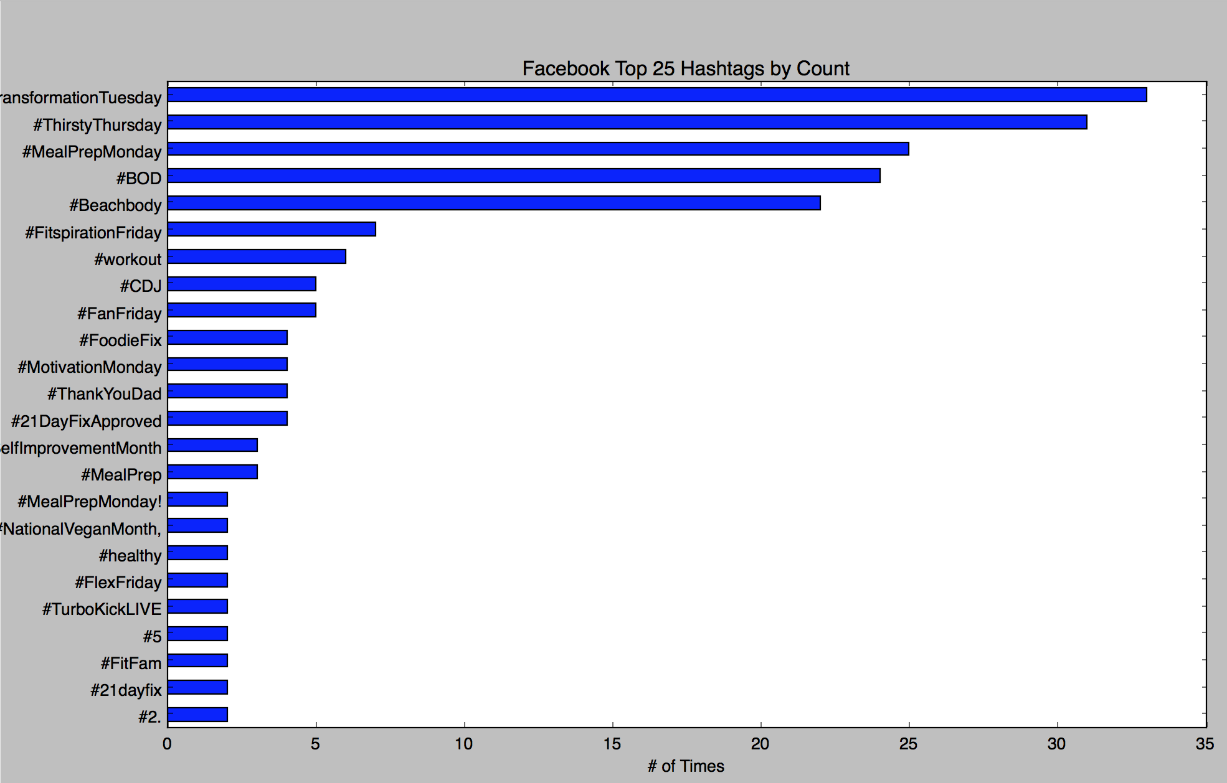
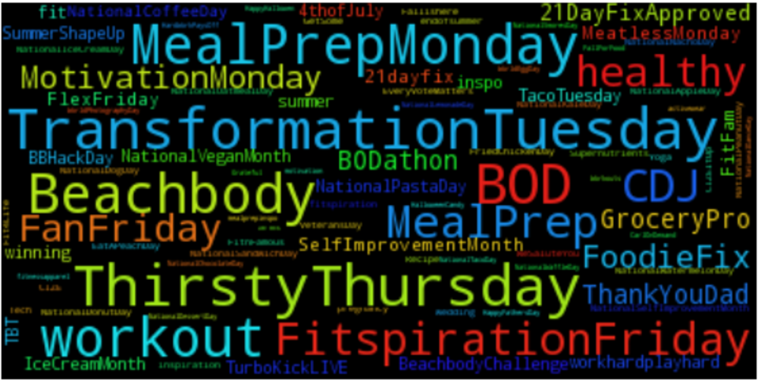
Facebook

Slide 20
Technical Solution

Slide 21




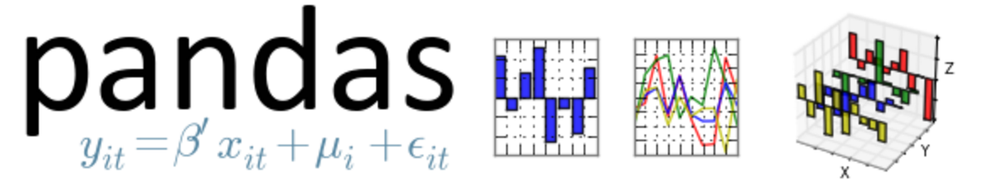


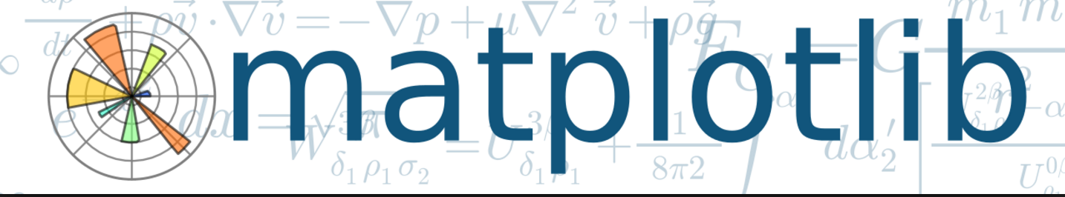

Technical Architecture - Layers
Source
Data Extraction (APIs)
Data “Transformation” and Storage
Analysis and Presentation
Sentiment
Analysis
Geo-referential
Graphs
Graphics

Slide 22
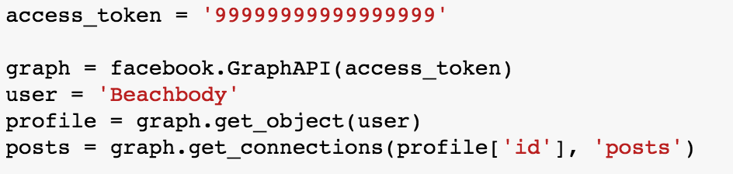
How was the data extraction done?
Examples of APIs used:
API
Response
API
Calls
https://api.twitter.com/1.1/search/tweets.json?src=typd&q=%40Beachbody
https://api.twitter.com/1.1/users/search.json?q=(name of user)
Python Program

Slide 23
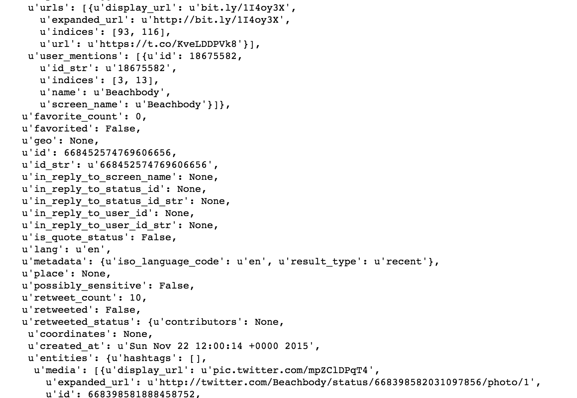
How was the data extraction done?
Examples of API response :
API
Response
API
Calls
Python Program
Response Parsing

